Slide 1

DATA SCIENCE CONSULTING
Session-1
Guillaume d'Hérouville
Kaan Caylan
Amjad Rehan Ibrahim
Thomas Schnieder
Shihan Ye
Harshit Shangari

Slide 2
Market trends leading to a higher churn rate
Increasing competition:
Increased supplier options may lead to lower prices and higher churn
rates
Deregulation:
Reduction in government regulations may open doors for new market
players
Economic downturns:
Recessions can impact demand for energy and affect industries
Technological advances:
Smart grids and digital platforms can make it easier for
customers to change suppliers
Sustainability concerns:
Cost-competitive green energy solutions may lead to more
customers switching to green energy suppliers.
Sources:
Market research and analysis, industry reports and publications.

Slide 3
Price Comparison
Methodology:
Assumptions: Standard household consumption
Method: Average prices comparison of top 5 energy suppliers in France.*
Characteristics: Price
Why price benchmark:
Important factor in consumer decision-making
Understand competitive pricing
Cost savings for consumers
Encourages suppliers to maintain competitive pricing
Promotes efficient market
Sources:
https://www.fournisseurs-electricite.com/en/edf
https://www.fournisseurs-electricite.com/en/engie .
*Data for ENI was not found even after intensive research

Slide 4
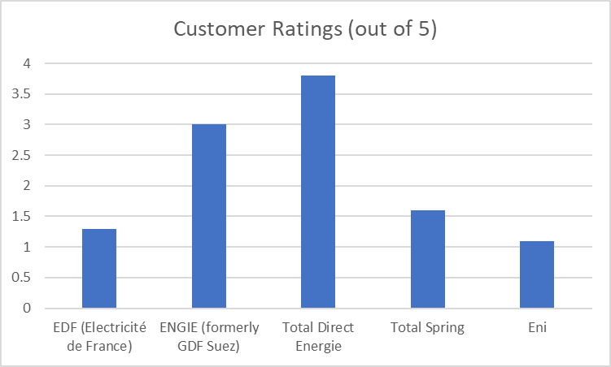
Customer Service
Methodology:
Assumptions: Standard households consumption
Characteristics: Reliability & Quality of customer service
Method: Comparison of customer service offered by top 5
Why customer service benchmark:
Important factor in consumer decision-making
Helps resolve issues quickly & efficiently
Identifies best service & customer support providers
Source:
https://fr.trustpilot.com/review/totalenergies.fr
https://fr.trustpilot.com/review/engie.fr
https://fr.trustpilot.com/review/edf.fr
https://fr.trustpilot.com/review/total-spring.fr
https://fr.trustpilot.com/review/eni.fr

Slide 5
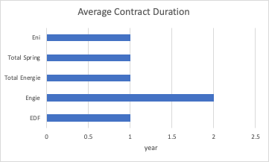
Contract Duration Comparison
Methodology:
Assumptions: Standard households consumption
Method: Average contract duration and termination fees of top 5 energy suppliers in France
Characteristics: contract flexibility
Why contract duration benchmark:
Important factor in consumer decision-making
Complexity to end up the current contract
Additional cost of termination fee
Sources:
https://www.edfenergy.com/sme-business/customer/renewals
https://particuliers.engie.fr/aide-contact/questions-reponses/mon-espace-client/contrat/contrat-se-termine-quand.html
https://en.selectra.info/energy-france/suppliers/total-direct-energie
https://www.total-spring.fr/
https://fr.eni.com/particuliers/indexee-eco-protection-plus-electricite
In France, customers can cancel an energy plan at any time free of charge, as providers are forbidden to apply fees for early cancellation.
Most contracts are yearly based for fixed price rate.

Slide 6
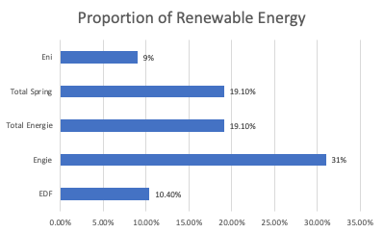
Renewable Energy
Methodology:
Assumptions: Standard households consumption
Characteristics: renewable energy proportion
Method: Comparison of renewable energy proportion of top 5 energy suppliers in France
Why renewable energy benchmark:
Important factor in consumer decision-making
Save consumptions for customers
Environmentally friendly
Source:
https://www.edf.fr/en/the-edf-group/producing-a-climate-friendly-energy#:~:text=In%20France%2C%20the%20electricity%20produced,nuclear%20power%20and%20renewable%20energies.
https://www.engie.com/sites/default/files/assets/documents/2021-09/ENGIE-ChiffresCle2021-EN-WEB_0.pdf
https://www.iddri.org/en/publications-and-events/blog-post/how-accelerate-renewable-energies-france-challenge-territorial#:~:text=At%20the%20European%20level%2C%20France,is%20greatest%20for%20renewable%20heat.
https://www.total-spring.fr/
https://www.eni.com/en-IT/eni-worldwide/eurasia/france.html

Slide 7
TotalEnergies – Steps and Pain Points
1
Stages
Awareness: Benefit of/ Need for new supplier
Consideration: Market Research
Evaluation: Choice of Shortlisted Supplier
Purchase: Choose Total & Sign Contract
Loyalty: Long term Satisfaction
2
Steps
Customer Relocates: no existing energy supplier & need for new supplier
Research of offer on Total website
Visits comparison site and review site (Trustpilot)
Gets advice from family and friends
Shortlists offers based on research
Receives tailored offer from energy suppliers
Books slot with technicians
Contacts customer service about price increase
Takes part in loyalty/ reward system
Contacts customer relations
Choice of offer
Signs contract
Technicians come to implement
Refers friends & family
Leaves good review
Customer is made aware of better offers
Clicks Facebook ad
Watches TV ad
Reads
print ad
Sees
ad at Airport
3
Touchpoints
Forum (Trustpilot/ Hellowatt),
competitor homepage
Campaign website/ homepage
Calls/ texts customer service
Gets offers by mail or email
Loyalty program on TE App
Reads & compares offers
Fills out Calendly form
Signs contract online
Welcomes technicians
Online survey/ forum
Facebook ad
Airport banner
Downloads TE App
TV ad
Print ad
Phone call
Homepage
4
Pain points
Red “Warning” Ribbon on Total Website
Lower price of competitors,
worse ESG,
bad reviews
Availability of technicians,
time until implementation
Electricity Outages
Bad customer service : waiting times, uncon-vincing explanation of price increases
Better
offer by competitor

Slide 8
Customer Journey TotalEnergies
5
9
11
12
1
2
3
4
6
7
8
10
I research the TotalEnergies offers
I contact Customer Service
I receive a custom plans from TotalEnergies
I choose the plan that I like best
I Sign the contract
I make the Payment
I book the appointment with the technician
The Technician comes to my house to make the necessary changes
I contact customer service about the price increase
I takes part in the reward system
I refer friends and family
I give feedback online
Online
Website
Social Media Online Chat
Mobile App
Phone
In Person
Offline
Direct touchpoint :
Available
Unavailable
The website can be accessed both through PCs as well as mobile devices. Social media is predominately accessed through mobile devices. Online chat is a feature that is implemented on TE's website and App and therefore can be accessed both through PCs and mobile devices. The Mobile App is exclusive to mobile devices.

